Slide 1
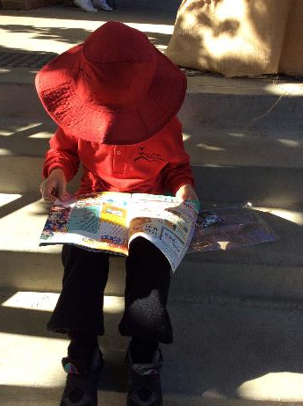
Information for Parents
Yarra Glen Primary School

Slide 2
Welcome to our school
Welcome to all families and students
Our uniform- A Plus Schoolwear- Sharyn Niddrie
Overview of our school- Sue Di Giacomo
Starting School, first day of school, Foundation program and buddy program- Trish Scott and Marie Martin, with special guests, Noah and Sienna
Questions

Slide 3
Preparing For School - what parents can do to help
establish a morning routine for your child to follow. For example, make own bed, eat breakfast, brush teeth, get self dressed, get hair done, put on sunscreen and put on shoes.
10-11 hours of sleep each night from around 7:30 p.m. Help your child to wind down about an hour before bed every night. Read together every night- share a book.

Slide 4
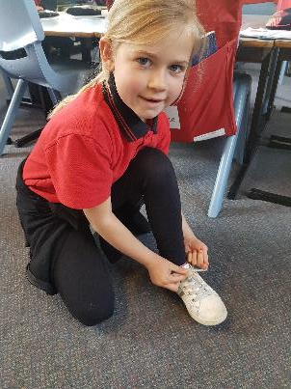
Preparing For School -things your child can try to feel confident and ready
dress self
brush own teeth
pack lunch box, drink bottle and hat
put on own shoes
practise writing own name
talk about the parts of a book
count, play cards and dice games

Slide 5
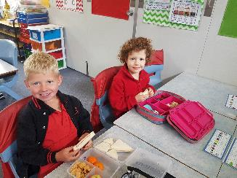
Getting Ready For School Days
breakfast is important
lunch box full of fresh, unprocessed foods, including some ‘brainfood’
water bottle- an everyday essential
confirm your before and/or after-school care arrangements, showing your child where the Outside School Hours Care facilities are
be positive about your child starting school

Slide 6
Helpful Websites and links
https://www.kidsmatter.edu.au/sites/default/files/public/KM_StartingSchool_InformationSheets_All.pdf
http://www.education.vic.gov.au/school/parents/primary/Pages/starting.aspx
http://raisingchildren.net.au/school/schools.html
These links can be found on our school website. A short information booklet is also included in your information packs.

Slide 7
First day of school
All students will begin Term 1 on Wednesday 31st January 2018.
Your child will receive a Christmas letter from us before the end of 2017 school year with the start time for them on the first day.
Foundation students have a staggered start time on the first day.

Slide 8
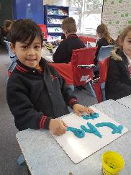
What to bring on the first day
Book pack- Please label your child’s school supplies and send to school on the first day. These supplies will be used and distributed throughout the year.
Playdoh- Playdoh is an excellent learning tool and also provides a wonderful tactile experience, increasing fine motor skills.
Art smocks- Art smocks are required for weekly art lessons and will be left at school all year.
Food- As well as lunch and snack-times, children will also be allowed to eat healthy ‘brain food’ snacks in the classroom throughout the day.
Hats- School hats are required to be worn by all students from the beginning of the year to the 1st May and then from the beginning of Term 4.

Slide 9
Things to discuss with your child’s teacher…
your child’s particular health and medical requirements (eg: allergies, asthma plans)
family events that may be affecting your child (for example, births, deaths, separation, divorce or other changes in family circumstances).
Any issues that may affect your child’s learning.

Slide 10
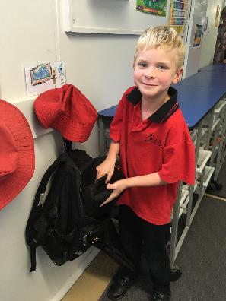
Before/after school procedures
On the first day, children in Foundation will be starting at staggered times and will be dropped off at the classroom. A letter will be sent home to you.
After the first week children should be dropped in the classroom by 9am when the bell rings.
For the first month, children should be picked up from the Foundation courtyard at 3.30pm. After this time you can choose an appropriate meeting place to collect your child.

Slide 11
Prep Entry Assessment
For approximately the first month your child will have Wednesday as a rest day (please note: students will attend on the first Wednesday)
On one of these Wednesdays, your child will be scheduled to come into school for one hour to participate in some one-on-one assessment in Literacy and Numeracy.
This assessment is informal and non-threatening and allows their teacher to design a learning and teaching program that best suits their individual needs.

Slide 12
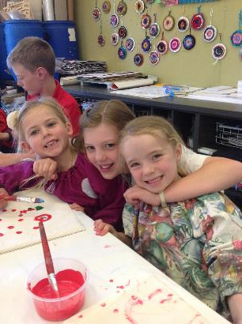
Buddy Program
2018 Grade 6 students are buddied with our new Foundation students and will be introduced to their buddies in the transition sessions that take place in November.
Grade 5 students complete written applications to become buddies and prior to their first meeting, undergo training to prepare them for any eventuality or situation that may arise!

Slide 13
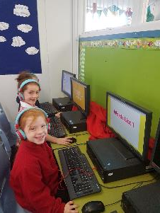
The Foundation classroom…
This year we have two Foundation-1 composite classes.
Tables are in clusters with engaging activities to promote Literacy, Numeracy and discovery.
Technology is everywhere with desktops in each class, interactive whiteboards and a bank of iPads for our students to use.

Slide 14
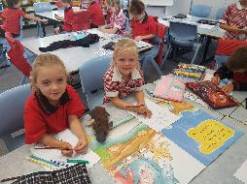
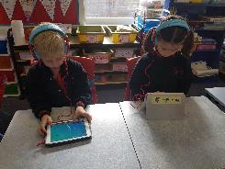
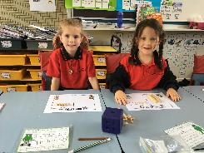
Our Curriculum Literacy & Numeracy
Early Years Literacy and Numeracy..
Literacy and Numeracy are part of our Strategic Plan at our school. This means they are both a very high priority. We continue to focus on best practice teaching and resourcing these curriculum areas so our students are engaged in their learning and love it!

Slide 15
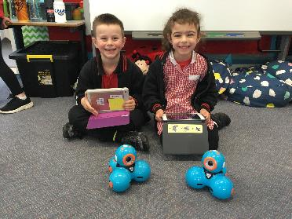
Robotics program
In the Junior school we have the use of 5 Dash robots. These robots can be integrated into all curriculum areas but will also teach students about simple coding, which is part of our new Victorian Curriculum.
Our robotics program continues into the senior school with the WeDo and EV3 Lego Mindstorm robots.

Slide 16
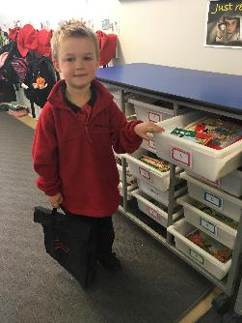
Home Reading
Home Reading will commence almost straight away.
Your child will be given a black satchel with their home reading diary and a book for them to read and a ‘read to’ book for you to read to them.
Each day, children will change their books in the classroom and reading diaries will be checked regularly.
Home Reading is such a wonderful support for your child, especially when they are learning to read and developing self confidence.
More information on home reading will be given at the beginning of the 2018 school year.

Slide 17
Sentral
Parents and teachers can communicate via Sentral
School can send reminders and notifications to parents about events etc
There are ‘communication protocols’ that will be sent home
Please make sure the office has a contact email and mobile number in case we need to contact you over the January period.

Slide 18
SHOWTIME!
Samples of the books your child will be taking home for home reading and student reading diaries.
Samples of Foundation students’ work

Slide 19
Questions
Thank you for your attentive listening
Question time

